Slide 1

International Hackathon 2025
Team 9
Speaker: Renato Mignone

Slide 2

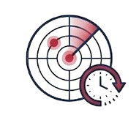
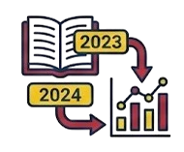

A Cockpit for Treasurers
Deadline Radar
Academic Year Logic
Smart Exports
A mandatory priority. Never miss a funding application with a dedicated tracking system for administrative and grant deadlines.
Budgets are strictly linked to academic years, keeping historical data accessible but distinct from current operations.
One-click CSV & PDF generation. All reports automatically convert timestamps to the user's local time zone.

Slide 3



Modern Technology Stack
Docker Containerization
Tech Stack
Database
automated make up workflow spins up a full Nginx-proxied stack. Includes automated seeding utilities and volume persistence to maintain state across development sessions.
Frontent:
React 18 + Vite. Fast, component-based UI with Recharts for data visualization.
PostgreSQL 16. Advanced relational data modeling that links users, budgets, and transactions. specialized schema handles complex academic-year logic
Backend:
Express 4. RESTful API architecture with JWT sessions and robust middleware.

Slide 4
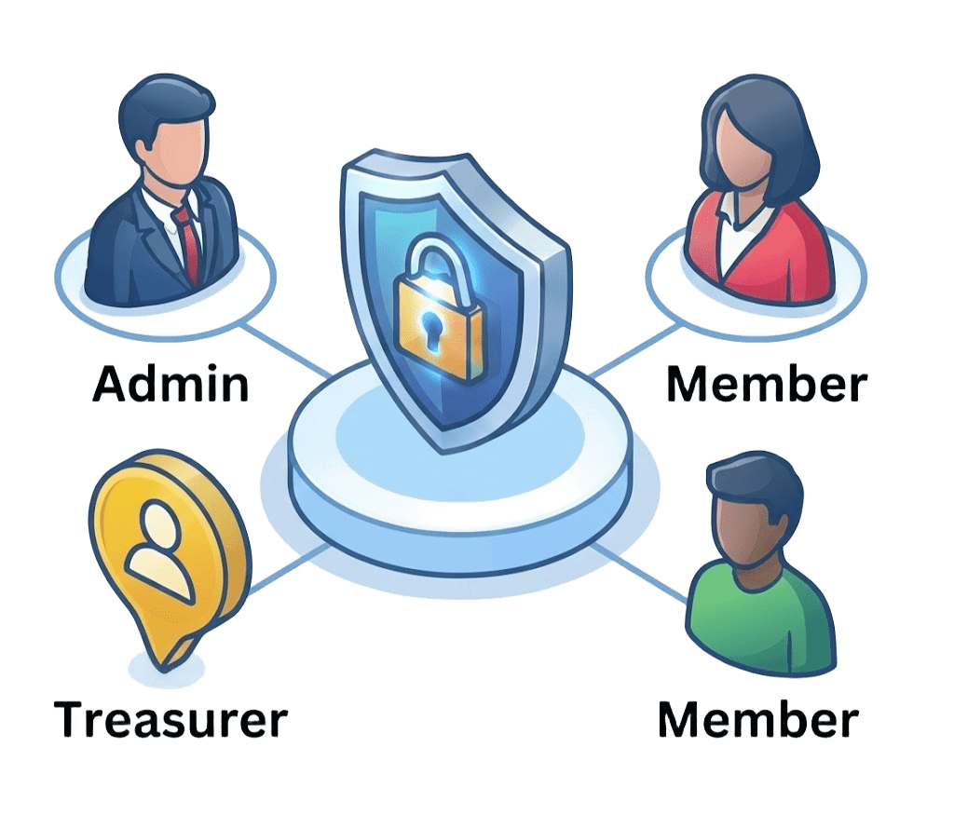



Advanced Features
Role-Based Access Control:
Distinct tiers for Admins, Treasurers, and Members to ensure data integrity.
Secure Authentication:
Fully implemented Google OAuth and TOTP Two Factor Authentication (2FA).
Event-Linked Budgeting:
Tie every dollar to a specific chapter activity for precise tracking.
Receipt Management:
Upload and attach digital proofs directly to transaction for effortless auditing.

Slide 5
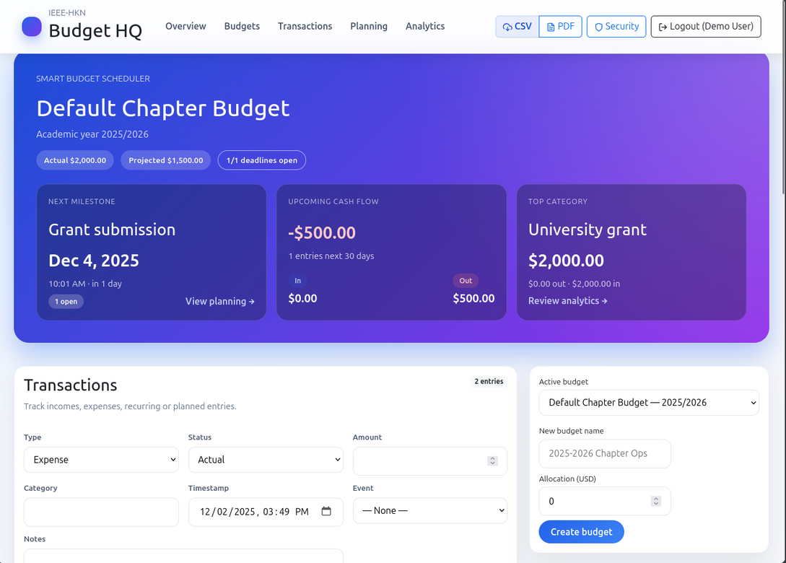
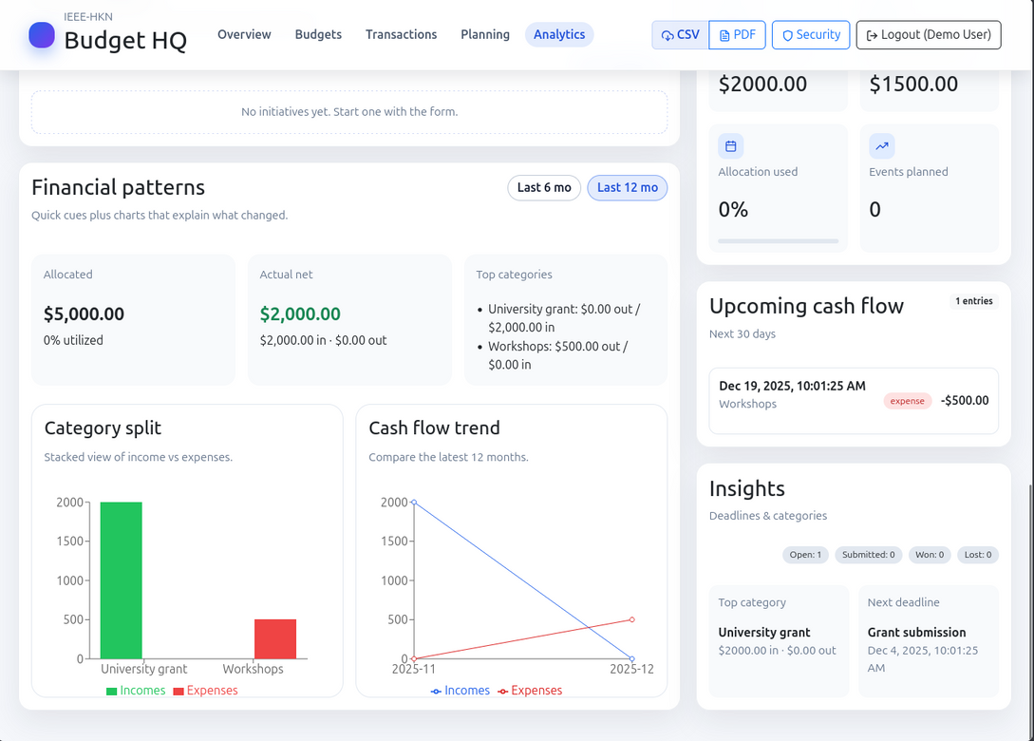
Application Demo - Desktop

Slide 6
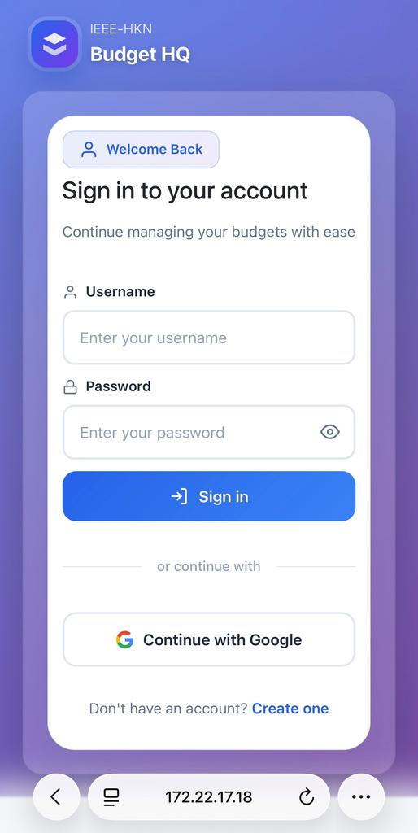
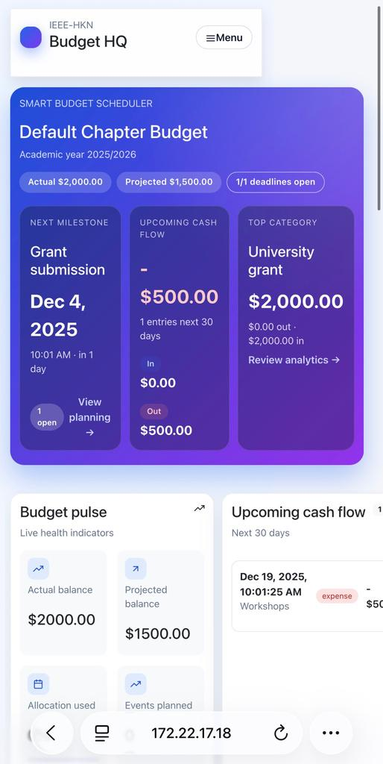
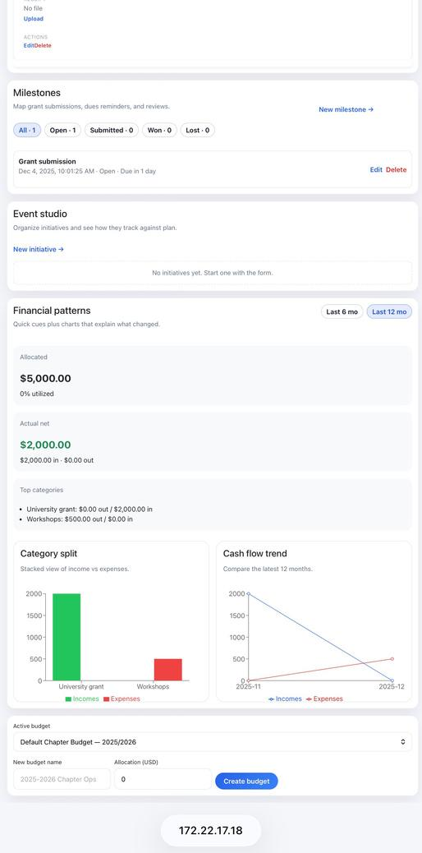
Application Demo - Mobile

Slide 7
Thank You! Connect with Us
Andrea Botticella
Simone Romano
andrea.botticella@hknpolito.org
simone.romano@hknpolito.org
@andrea-botticella
@Botti01
@simone-romano
@sroman0
Elia Innocenti
Eric Ruiz Giménez
Mu Nu Chapter
of IEEE-HKN
elia.innocenti@hknpolito.org
eric.ruizgimenez@hknpolito.org
@eliainnocenti
@eliainnocenti
@eric-ruiz-gimenez
@thismanera
Renato Mignone
Claudia Sanna
renato.mignone@hknpolito.org
claudia.sanna@hknpolito.org
@renato-mignone
@RenatoMignone
@claudiasanna1
@sananaclaudia

